Slide 2
WE ARE STRONGER TOGETHER

Slide 3
THE REGISTERED ORGANISATION

Slide 4
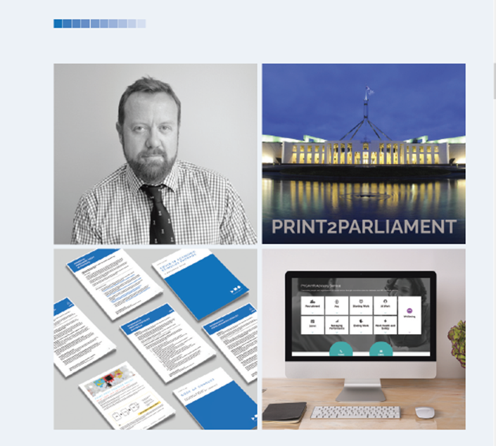
INDUSTRIAL AND WORKPLACE RELATIONS

Slide 5
SUSTAINABLE GREEN PRINT

Slide 6
CAMPAIGNS TO PROMOTE AND EDUCATE

Slide 7
CAMPAIGNS TO PROMOTE AND EDUCATE

Slide 8
CAMPAIGNS TO PROMOTE AND EDUCATE

Slide 9
P.o.P WEBINARS TO BUILD OUR BUSINESS SKILLS

Slide 10
AWARD AND CELEBRATE

Slide 11
PLAY YOUR ROLE AND SHARE YOUR VOICE

