Slide 1
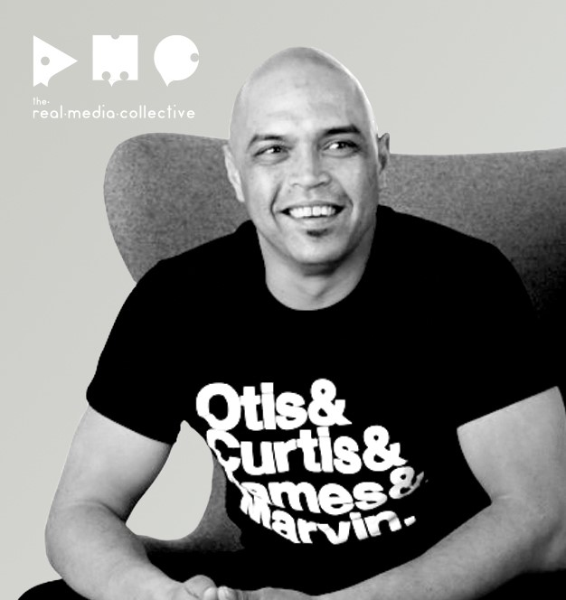
Hi, I’m Phil.
Notes:
Who are you – intro and talk about brands coming who are now seeking sustainable packaging design which has started a different approach and thinking that our team has sought guidance from our supply partners including printers.

Slide 2
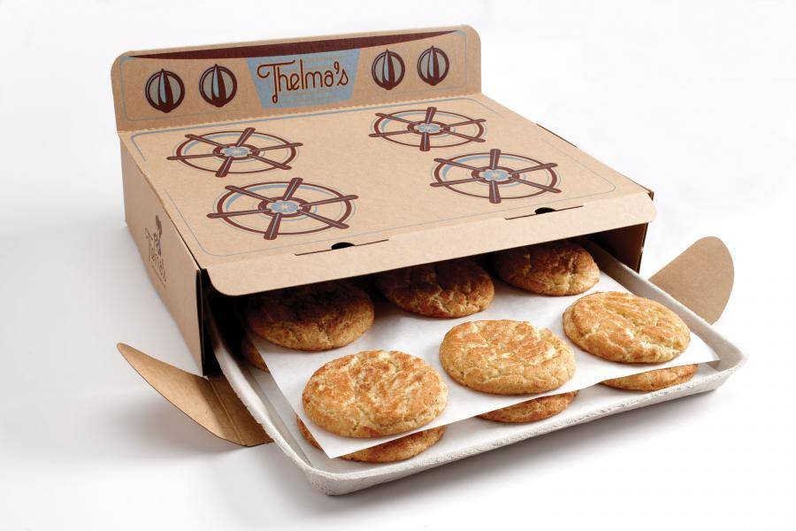
Packaging has new rules.
Notes:
Packaging has new rules – APCO and government are setting new targets, which means brands must conform, also consumers (toluna stats) want more sustainable packaging, consumers have a view of what sustainable is – recycled, household recycled etc. plastics are out. Single use plastics are definitely out. Brands don’t want to be all brown board so they need us to create solutions that sing, but also are sustainable.

Slide 3
The new rules are cool.
Notes:
The new rules are cool – we don’t need plain recycled papers, the new rules are cool. Foiling options with recyclability, blind embossing, paper ranges, folds and science. Talk about the OMO packaging and refill solutions. Paper is more tactile and memorable than plastic, so this communicates to the product being more memorable and therefore more sales and band loyalty. Using paper and folds and finishes breathes a life into packaging that has been lost in previous years however with sustainability now being the fore, we are all able to build change and creative solutions that also save the planet which is really cool.

Slide 4
Limited only by our curiosity.
Notes:
The world is our oyster – with all the technology and innovation being placed into recycled, compostible and sustainable products, we are only limited by our imaginations. Talk about L’Oreal zero waste program globally. Paper sculptures, circular economy, new packaging paper grades, folding dies being pushed – no more square boxes. Packaging isn’t just cardboard, it’s tissue paper – labels and more to bring a brand presence as a part of the end to end journey – Steve jobs quote. Apple quote.

Slide 5
We can do it together.
Notes:
We can do it together – The first step is to understand your role, as a sales rep – understand the changing world of graphic packaging and share these ideas with your design and brand customers – be part of the conversation. For ops and technical people, understand the options and be open minded – there is never a no, rather a ‘let’s work out how’. Embrace you supply partners, B&D, Avon and more. They know which products are emerging, are sustainable and they are also the most passionate when sharing the great product ranges they have. Use their expertise. Engage with The Real Media Collective who are pulling together a guide across all the products available and their environmental credentials. Sharing knowledge together will be the best foot forward for your customers and ultimately your business.

