Slide 1


Slide 2

The real media collective

Slide 3

The real media collective

Slide 4

The real media collective

Slide 5
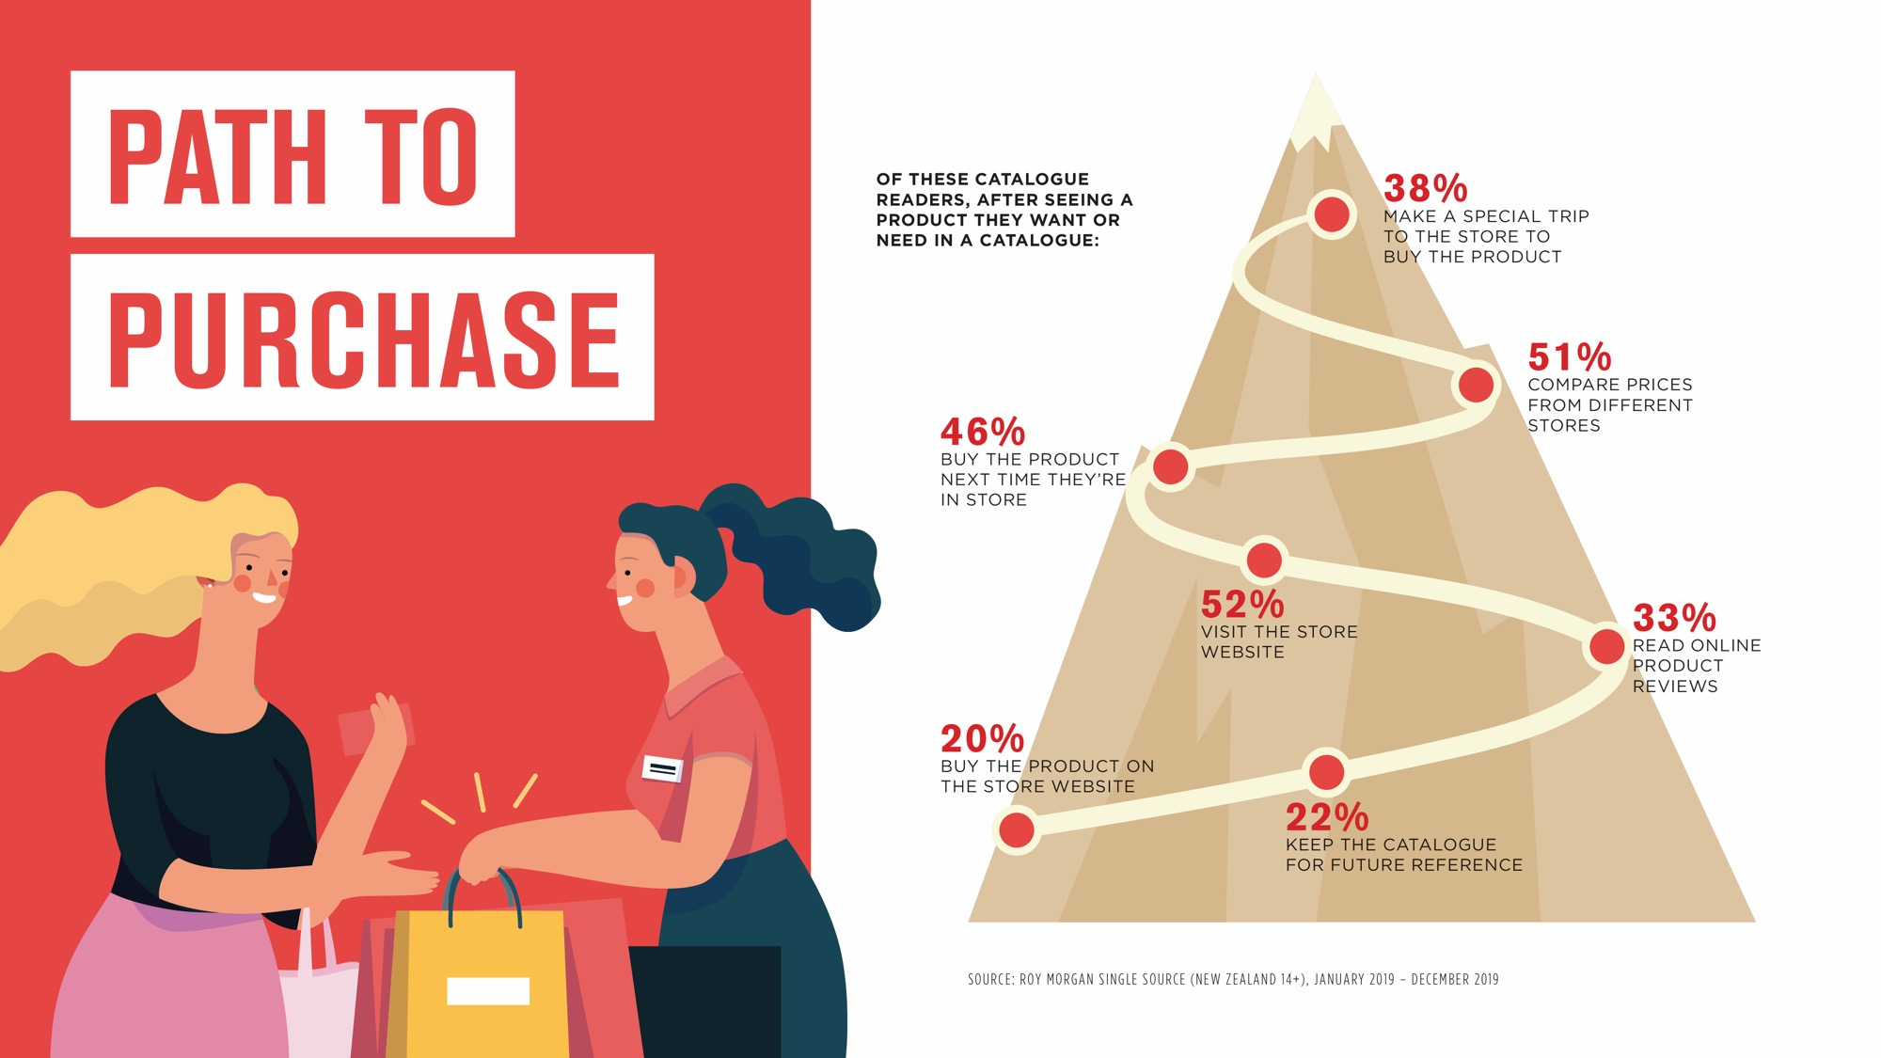
The real media collective

Slide 6

The real media collective

Slide 7

The real media collective

Slide 8
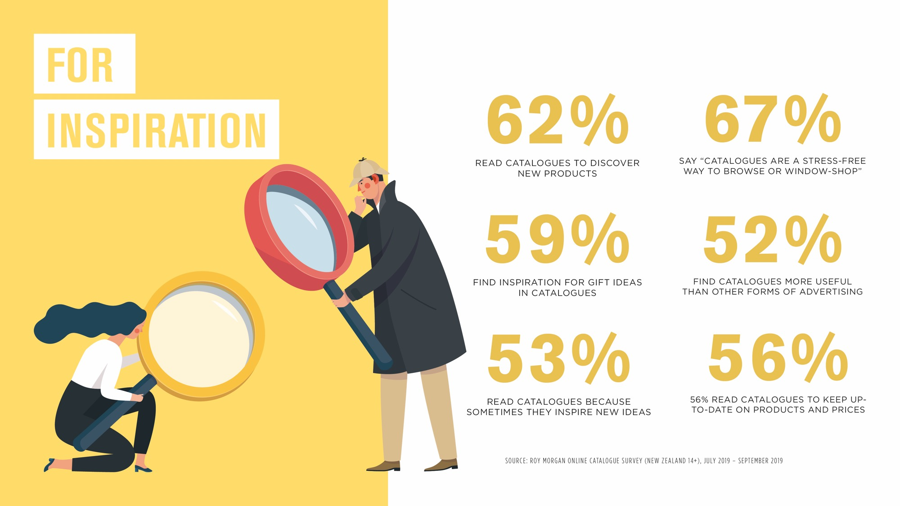
The real media collective

Slide 9
PUSH THE CHANNEL WITH EVERY STEP
The real media collective
RESULT FROM FIRST CAMPAIGN PERIOD BEST EVER. A RECORD NUMBER OF NEW ACCOUNTS OPENED EACH DAY
IN AREAS WHERE LETTERBOX MEDIA WAS DELIVERED THERE WAS A SIGNIFICANT INCREASE IN NEW CUSTOMERS (UP TO 62%) COMPARED TO A NATIONWIDE AVERAGE OF 9.3%

Slide 10
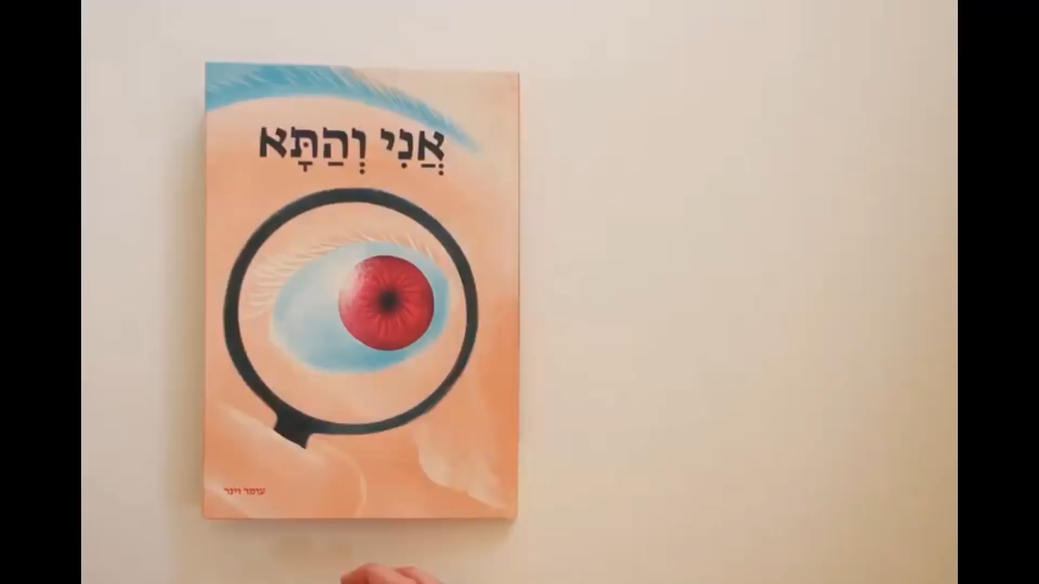
CREATE YOUR
OWN TALKABILITY
The real media collective

Slide 11
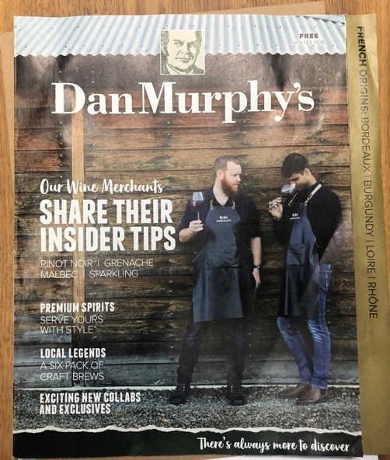
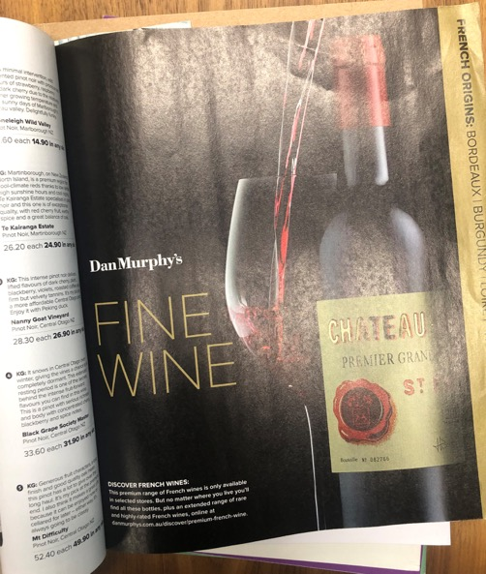
PUSH EACH AND EVERY CHANNEL
The real media collective

Slide 12

THANK
YOU!
+61 3 9421 2206
hello@thermc.com.au
Suite 6, 151 Barkly Avenue Richmond VIC 3121 Australia
Check out more examples:
www.vopp.com.au
www.therealmediacollective.com.au

