Slide 1


Slide 2


Slide 3



GET A GRIP
ON YOUR BUSINESS
What does SUCCESS look like coming out of
COVID-19, and how to put yourself back in
the Driver’s seat?
Dave Webster, TRACTION6
david.webster@traction6.com.au
0408-823-006

Slide 4

Agenda
Get REAL
Keep it SIMPLE
Get RESULTS

Slide 5
REAL.
Get

Slide 6

THE 5 COMMON FRUSTRATIONS
LACK OF CONTROL - Time, market, and outside forces.
You are not controlling your business, it is controlling YOU!
PEOPLE - Employees, customers, vendors, partners not listening, following through, not on the same page.
PROFIT - Simply put, there is not enough of it!

Slide 7
THE 5 COMMON FRUSTRATIONS
HITTING THE CEILING - Your growth has stopped. You can’t get to
the next level - you feel overwhelmed and unsure of what to do next.
NOTHING’S WORKING - You are trying various strategies and quick
fixes but not breaking through! Your people have become numb to
new ideas. You are spinning your wheels and need some traction to
move again!

Slide 8

THE 3 BUILDING BLOCKS TO SUCCESS
VISION
  Ensure that your management team is 100% on the same page
  with where your organization is going and how you are going
  to get there?
TRACTION
  Help your management team become more disciplined and accountable in executing on every part of your vision.

Slide 9
THE 3 BUILDING BLOCKS TO SUCCESS
HEALTHY
  Helping your management team to become a healthy, functional, and cohesive team, because unfortunately, leaders in a business do not always work well as a team.
As the management team goes, so does the rest of the organization.

Slide 10

WHAT DOES SUCCESS LOOK LIKE?
  Successful businesses operate with a crystal
clear vision that is shared by everyone.
  They have the right people in the right seats.
  They have a pulse on the business by watching
and managing a handful of numbers on a weekly basis.

Slide 11
  They identify and solve issues promptly in an open
  and honest environment.
  They document their processes and ensure that
  they are followed by everyone.
  They establish priorities for their employees
and ensure a high level of trust, communication and
accountability exists throughout the whole organization.

Slide 12
SIMPLE.
Keep it

Slide 13






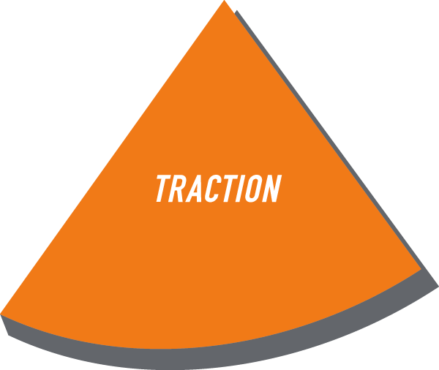
The 6 Key Business
Components

Slide 14
“VISION without TRACTION is hallucination”
  - Gino Wickman

Slide 15
The 6 Key Business
Components
100%
GOAL 80%
0%

Slide 16
The 6 Key Business
Components
100%
MOST 20%
0%

Slide 18
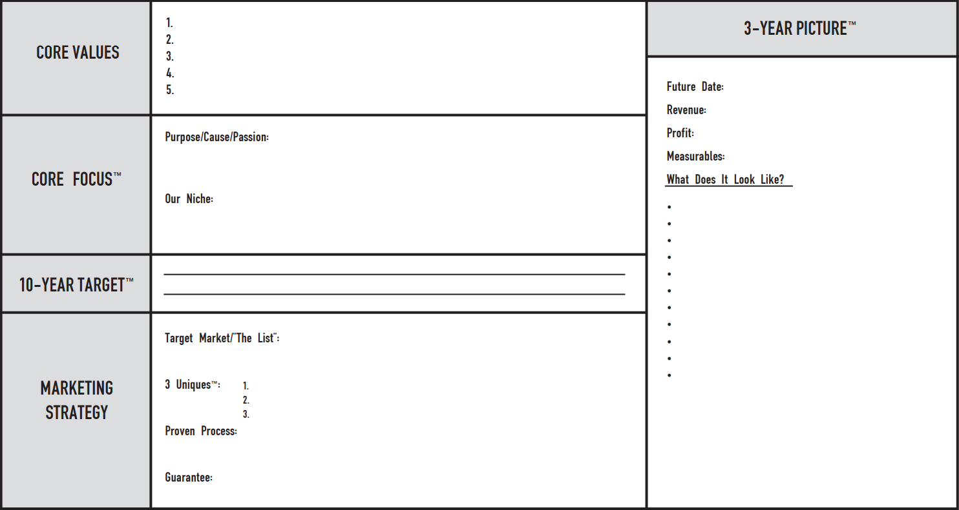
The Vision/Traction Organizer™

Slide 19
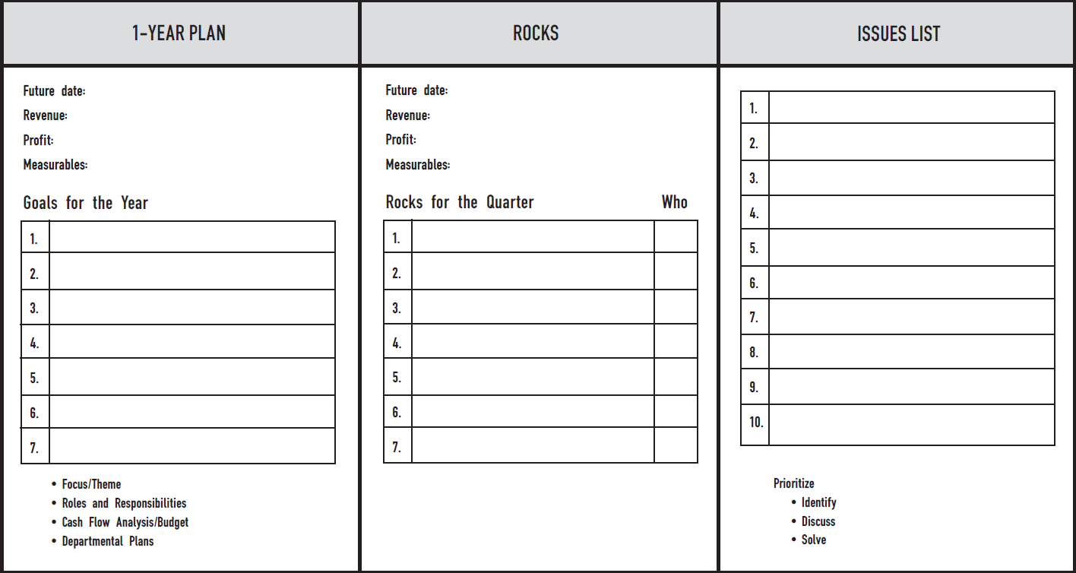
V/TO™

Slide 20

100% STRONG

Slide 22
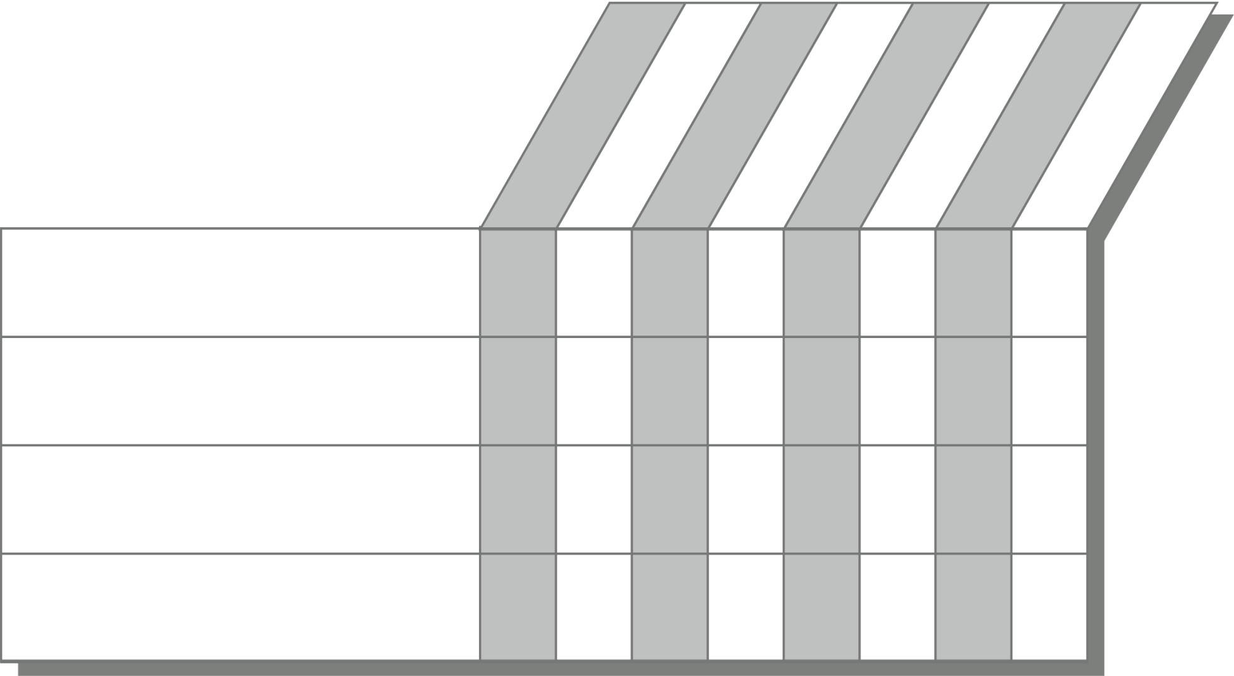
The People Analyzer™
Do what you say
Help first
Grow or die
Do the right thing
Humbly confident
Name
JoAnn Wright
+
+
+
+
+
Martin Gilbert
–
+/–
–
–
+/–
Ellen Smith
+/–
+/–
+
+/–
+
The Bar
+
+/–
+
+/–
+

Slide 23
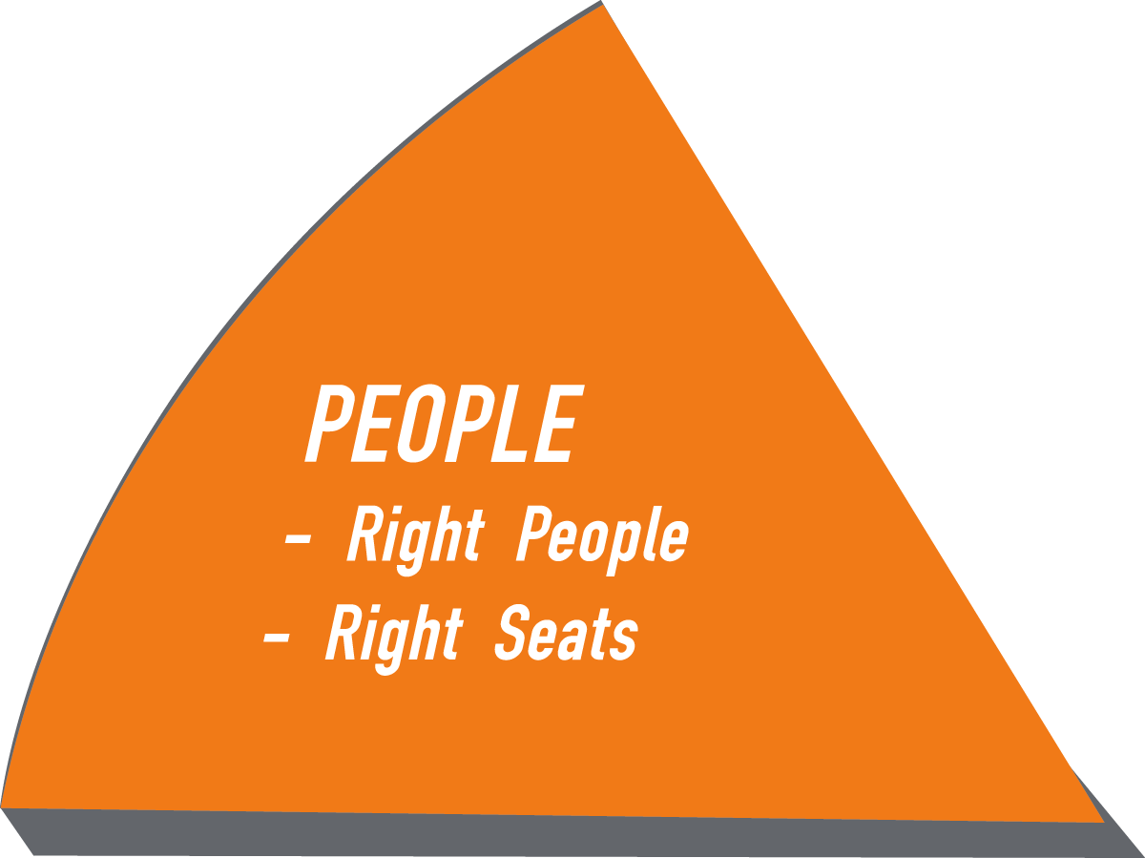

Slide 24
“Structure First, People Second”
  - Gino Wickman

Slide 25
The Accountability Chart
VISIONARY
INTEGRATOR
MARKETING/SALES
OPERATIONS
FINANCE

Slide 26
Right SEATS
Function
Name
Role
Role
Role
Role
Role

Slide 27
Right SEATS
Marketing/Sales
Name
LMA
Marketing
Hit sales numbers
Sell
Account management

Slide 28
Two Kinds of PEOPLE ISSUES
Right Person, Wrong Seat
Wrong Person, Right Seat

Slide 29
100% STRONG

Slide 31
“If we have data, let’s look at the data.
If all we have are opinions, let’s go with mine.”
- Jim Barksdale, former Netscape CEO

Slide 32
Company SCORECARD
WHO
MEASURABLES
GOAL
30
-
Sep
7
-
Oct
14
-
Oct
21
-
Oct
28
-
Oct
4
-
Nov
11
-
Nov
18
-
Nov
25
-
Nov
2
-
Dec
9
-
Dec
16
-
Dec
23
-
Dec
Anne
Weekly Revenue
>=$84,500
$92,000
$85,238
$81,200
$80,934
$88,678
$88,200
$85,321
$80,282
$95,291
$100,281
$86,200
$78,290
$83,498
Anne
Cash Balance
>=$14,245
$16,230
$15,200
$12,289
$11,989
$14,980
$15,123
$14,989
$11,291
$17,281
$18,359
$15,289
$10,221
$11,189
Robert
Sales Calls
50
54
55
61
59
32
48
51
72
61
54
50
52
54
Robert
Sales Meetings
10
10
10
10
8
10
10
12
11
15
10
9
8
8
Robert
Proposal
5
5
5
6
5
6
5
6
4
5
8
6
5
5
Robert
Closed Business
2
2
3
6
3
2
3
5
3
2
1
2
8
4
David
Customer Satisfaction
>=80%
80%
80%
80%
80%
80%
80%
80%
80%
80%
80%
80%
80%
80%
Claire
Accounts Payable
<$8,000
$8,450
$9,234
$3,450
$5,500
$4,300
$8,900
$2,300
$5,409
$4,390
$9,032
$3,445
$2,300
$5,009
David
Errors
<=4
3
2
2
2
2
1
2
3
0
0
0
2
1
John
Utilization/Capacity
>75%
75%
76%
75%
75%
75%
75%
75%
82%
75%
75%
78%
75%
75%

Slide 33
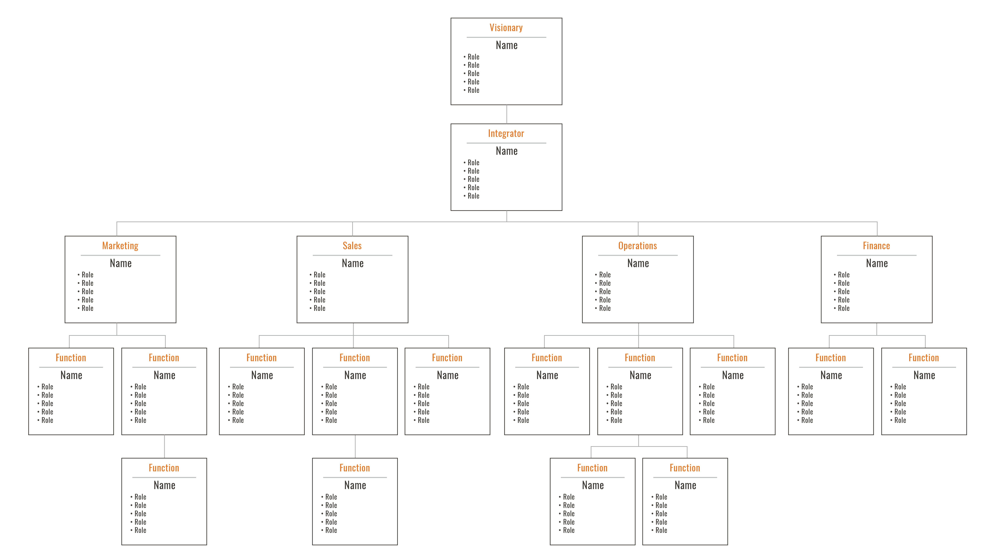
Measurables

Slide 34
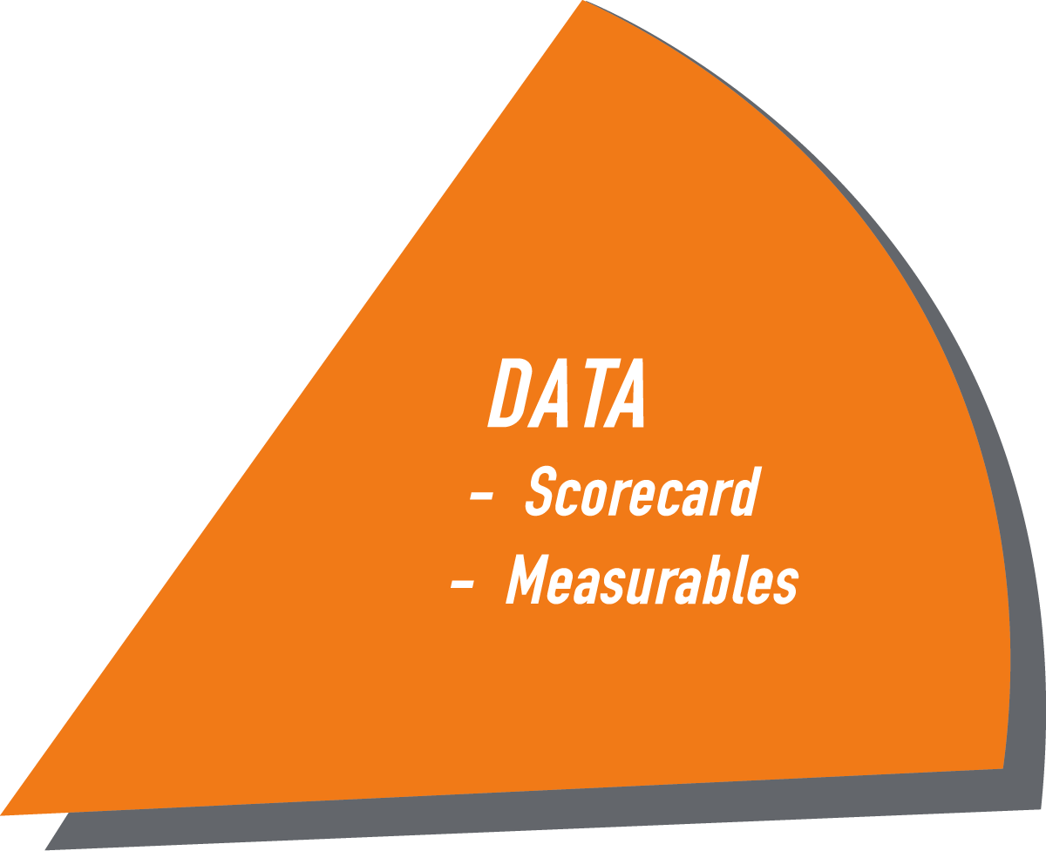
100% STRONG

Slide 36


Slide 37
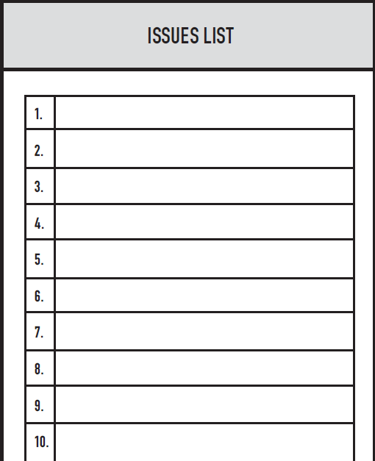
Issues Solving Track
I
D
S
Identify
Discuss
Solve
2
Website Rock off-track
Darren U. Right Person
Andi S. Right Seat
Sales off-track
Anodyne Merger
Utilization off-track
Western US expansion
1
3

Slide 38
100% STRONG

Slide 40
and Simplify
Document
Sales Process
New Lead
  -----------------
Initial Call/Qualify
  -----------------
  -----------------
  -----------------
Fit Meeting
  -----------------
  -----------------
Proposal
  -----------------
  -----------------
Win/Lose
People Process
ID Need
--------------------------------
Define Seat
--------------------------------
--------------------------------
Hiring
--------------------------------
--------------------------------
On-Boarding/Training
--------------------------------
--------------------------------
LMA
--------------------------------
--------------------------------
Termination
--------------------------------
--------------------------------

Slide 41
“Your Company Way”
Table of Contents
People
Marketing
Sales
Operations
Accounting
Customer Service
People Process
ID Need
--------------------------------
Define Seat
--------------------------------
--------------------------------
Hiring
--------------------------------
--------------------------------
On-Boarding/Training
--------------------------------
--------------------------------
LMA
--------------------------------
--------------------------------
Termination
--------------------------------
--------------------------------

Slide 42

100% STRONG

Slide 44

Meeting Pulse™
90-Day World™
Meeting Pulse
    Same Day
    Same Time
    Start on Time
    End on Time
    Same Agenda

Slide 45

Level 10 Meeting ™
Good News 5 Minutes
Scorecard 5 Minutes
Rock Review 5 Minutes
Customer & Employee Headlines 5 Minutes
To Do List 5 Minutes
Issues List/IDS 60 Minutes
Conclude 5 Minutes
Reporting Only

Slide 46

100% STRONG

Slide 47
RESULTS.
Get

Slide 49
“Real. Simple. Results.”
Thank you!
Dave Webster, TRACTION6
david.webster@traction6.com.au
0408-823-006

Slide 50


Slide 51
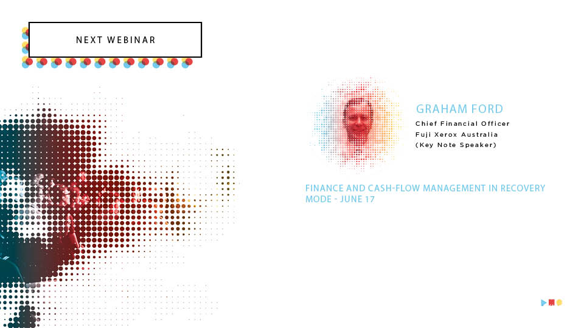

Slide 52


